Slide 1
Video-Audio Converter(Saptang Labs) Developing a dynamic web application that converts a video to audio and allows user to download a text file that can include timestamps,tags and comments for the resulting audio file. Technologies I used: HTML, CSS , JavaScript, NodeJS, ExpressJs , FFmpeg, EJS, BOOTSTRAP

Slide 2
OverView: In this project I have created a dynamic web application, ready to be deployed on World Wide Web(www). The technologies that I used for frontend development includes HTM,CSS,BOOTSTRAP and JavaScript….. For backend development I used NodeJS, ExpressJS and some of the important node modules…… For video to audio conversion I have used Ffmpeg which is one of the leading multimedia framework able to decode, encode,transcode,mux and play pretty much anything that humans and machine have created…..

Slide 3
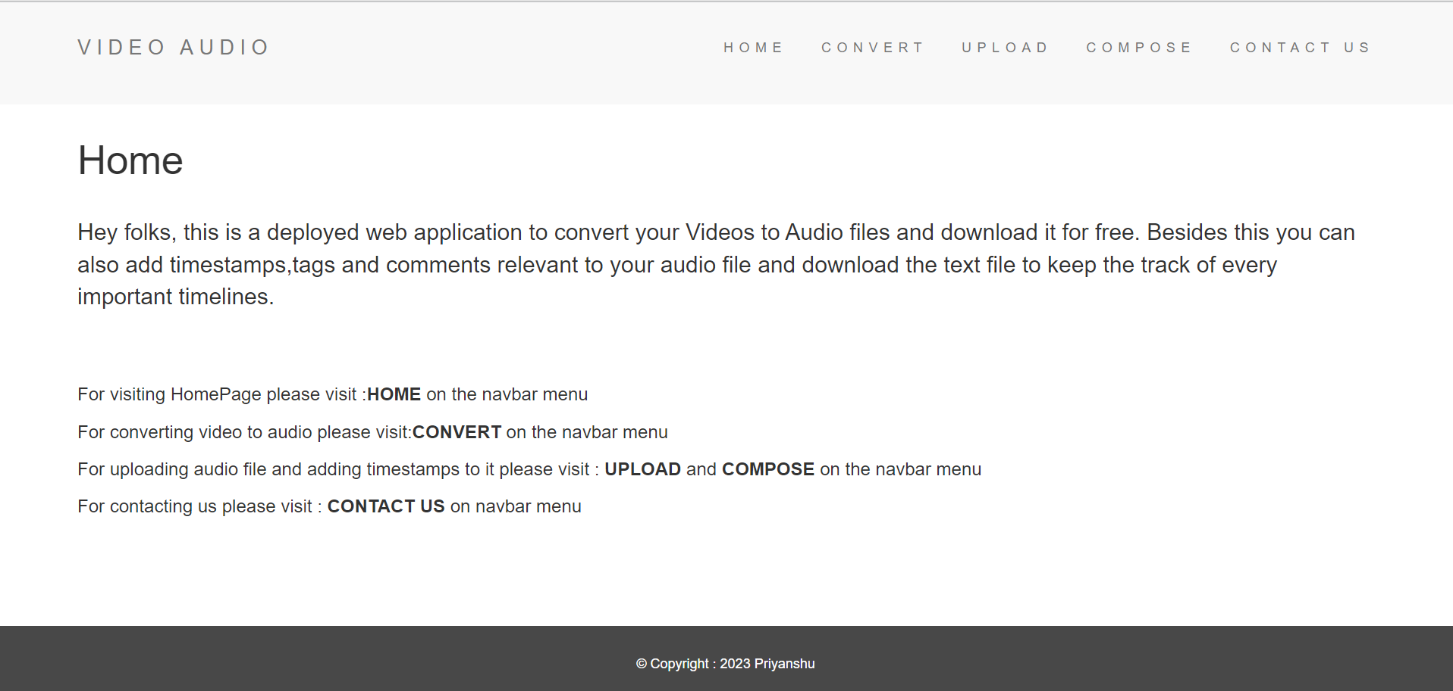
Homepage of my Web Application

Slide 4
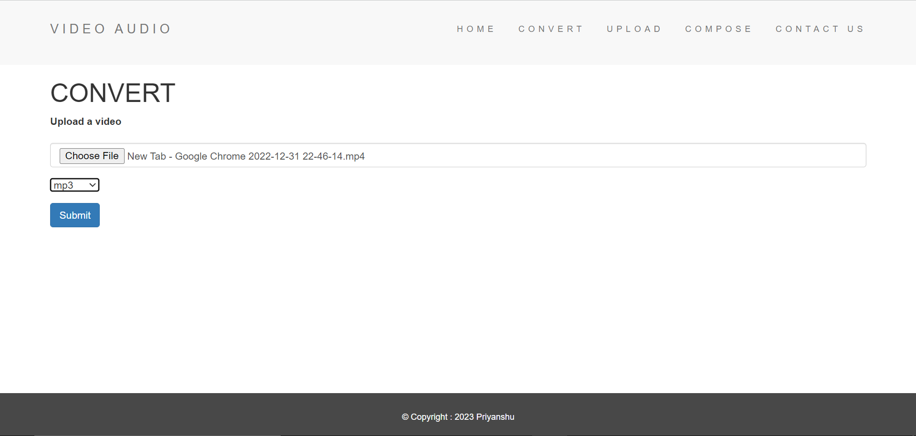
Convert video--->audio

Slide 5
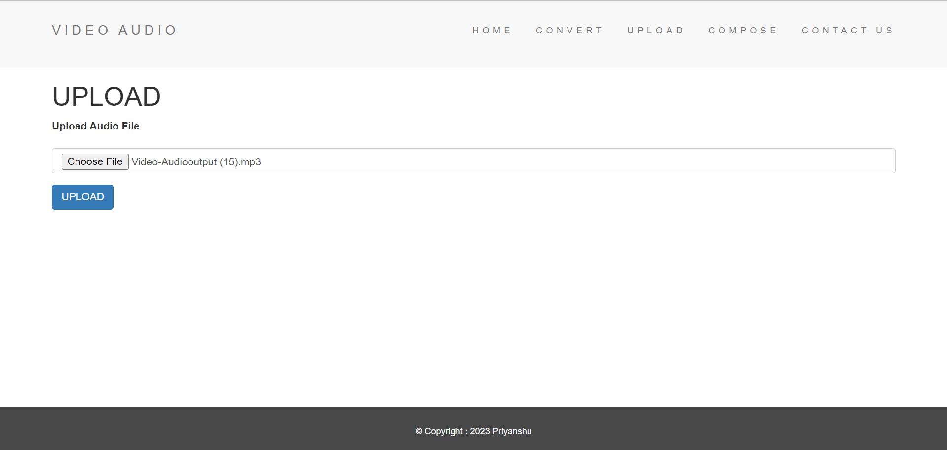
Upload Audio file

Slide 6
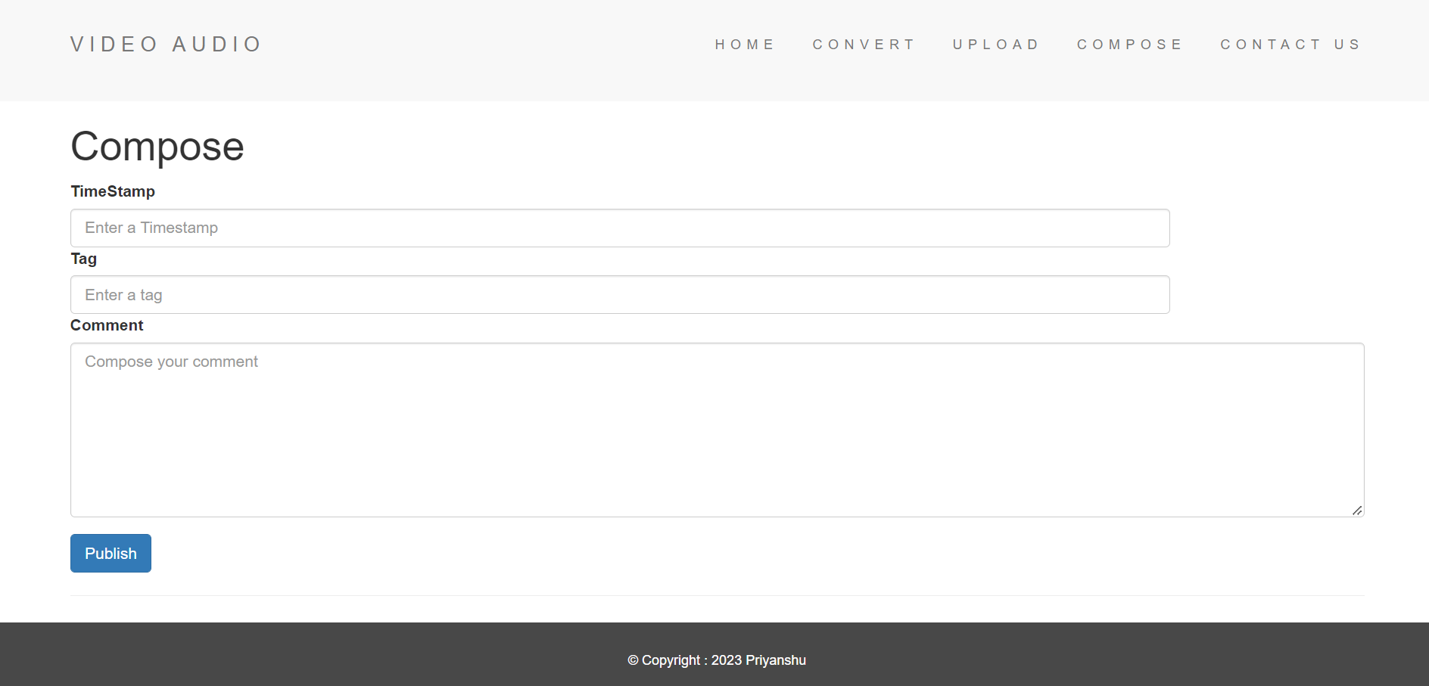
Composition of Timestamps, Tags and Comments

Slide 7
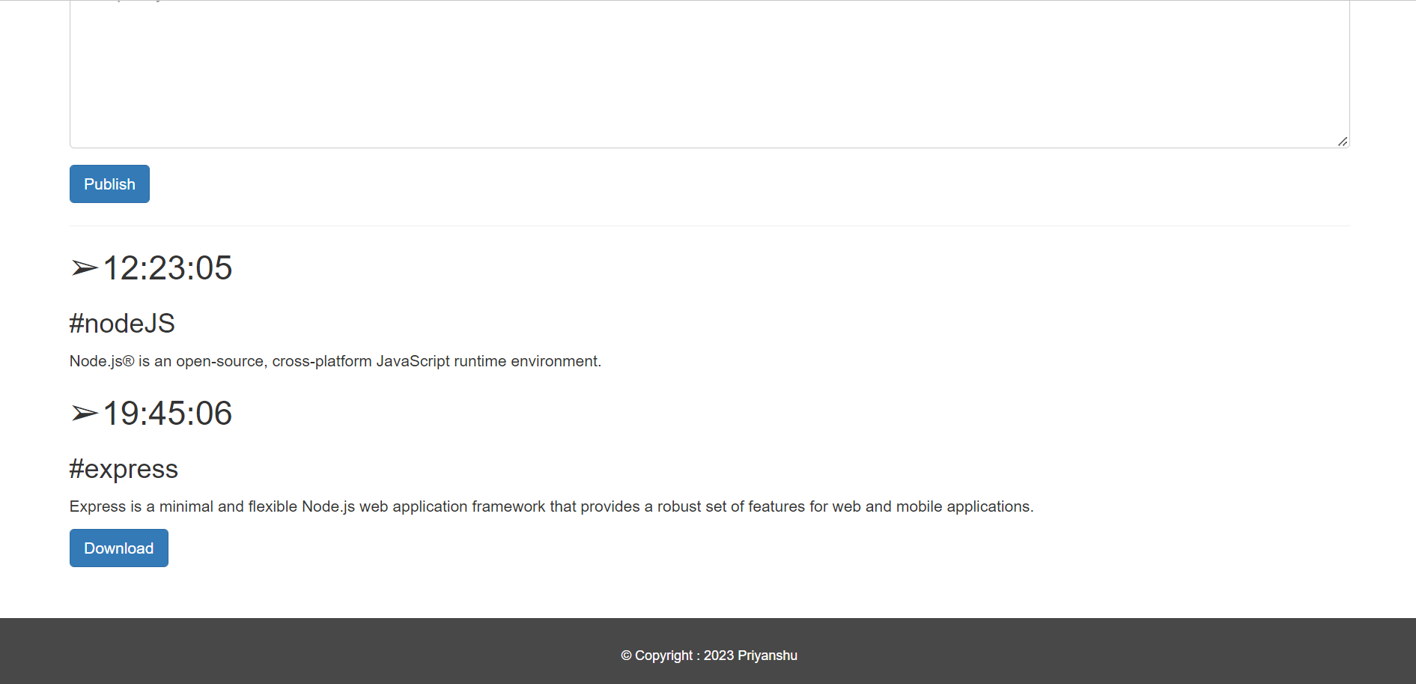

Slide 8
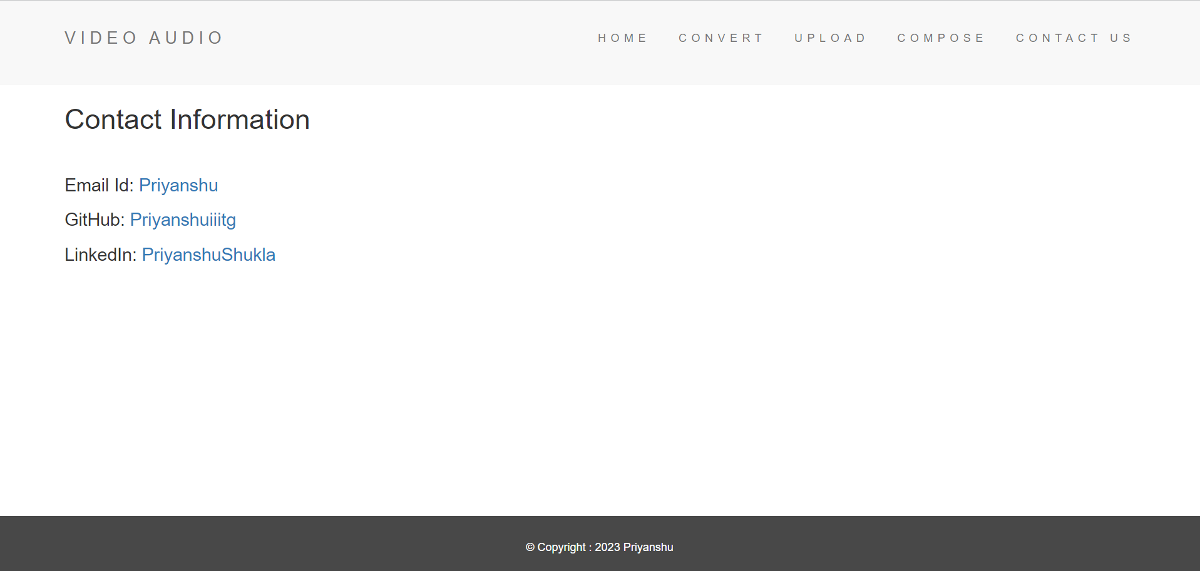
Contact Details

Slide 9
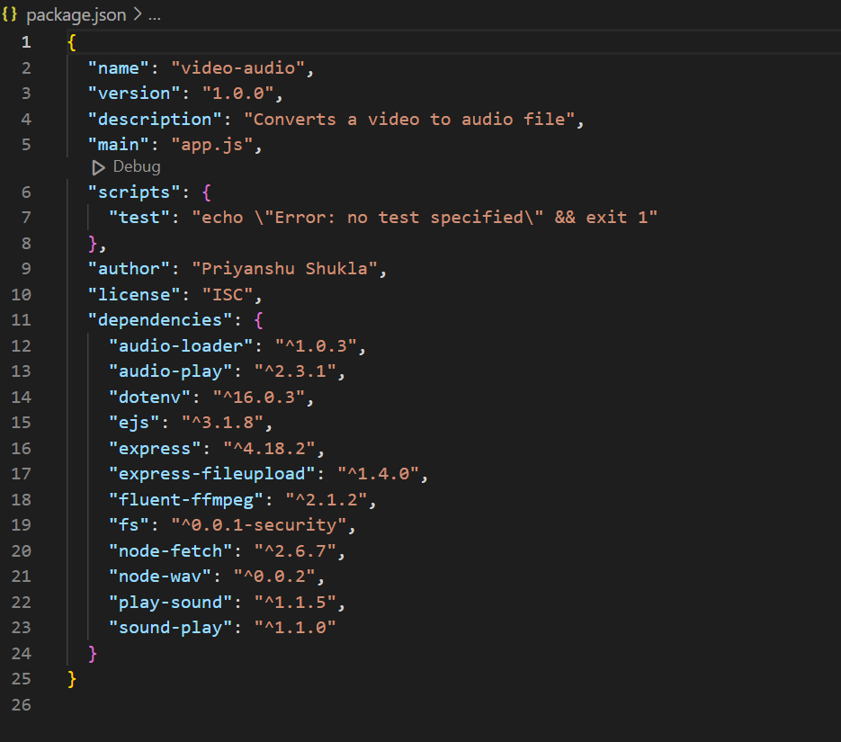
This is the package.json{} that I included while development of application

Slide 10
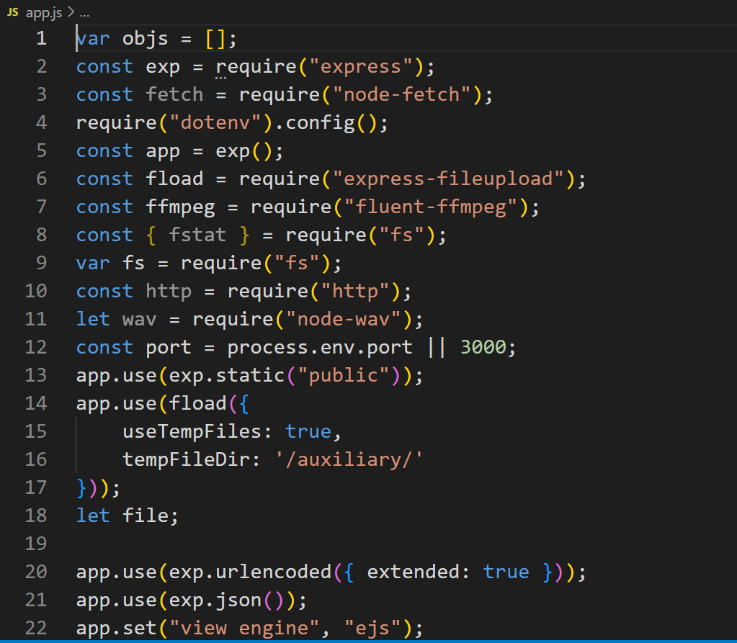
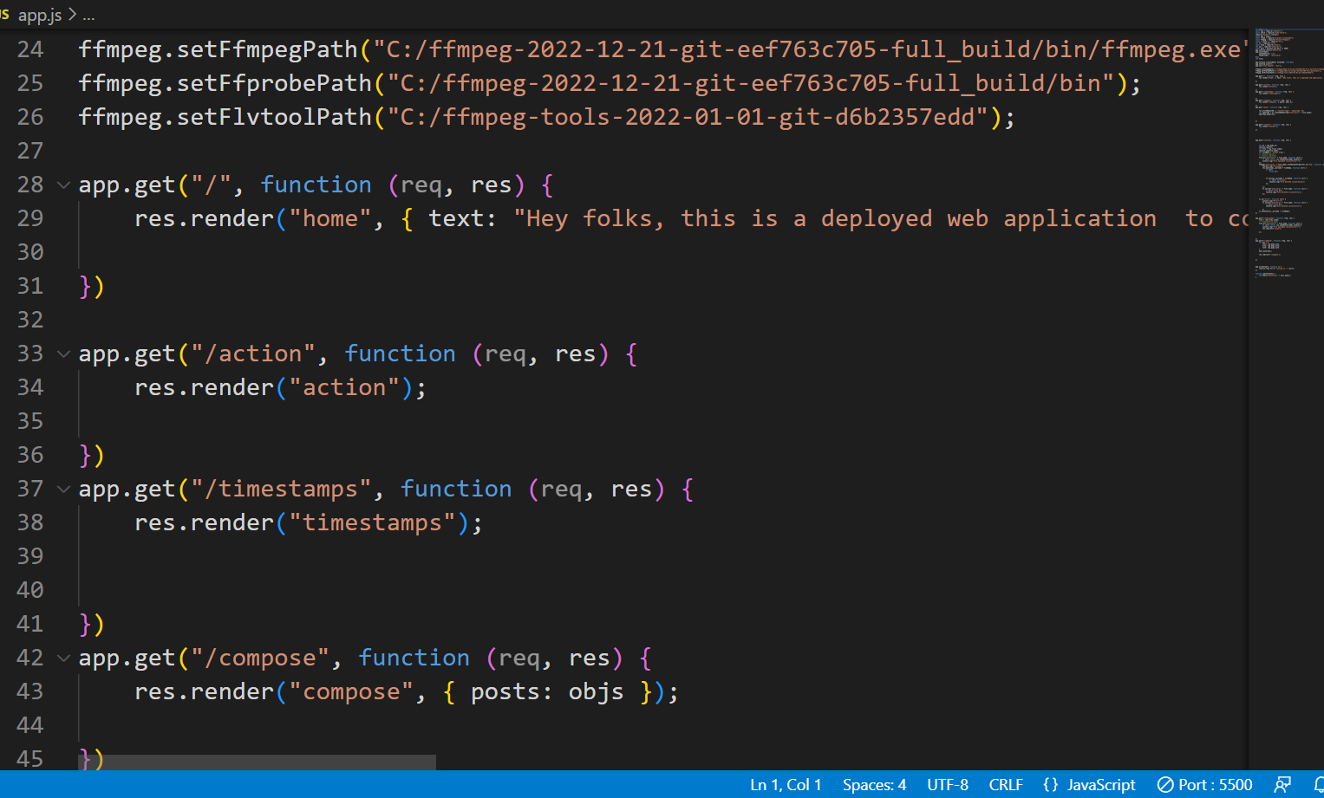
These are some of the glimpses of my application.js which is the entry point of this application

Slide 11
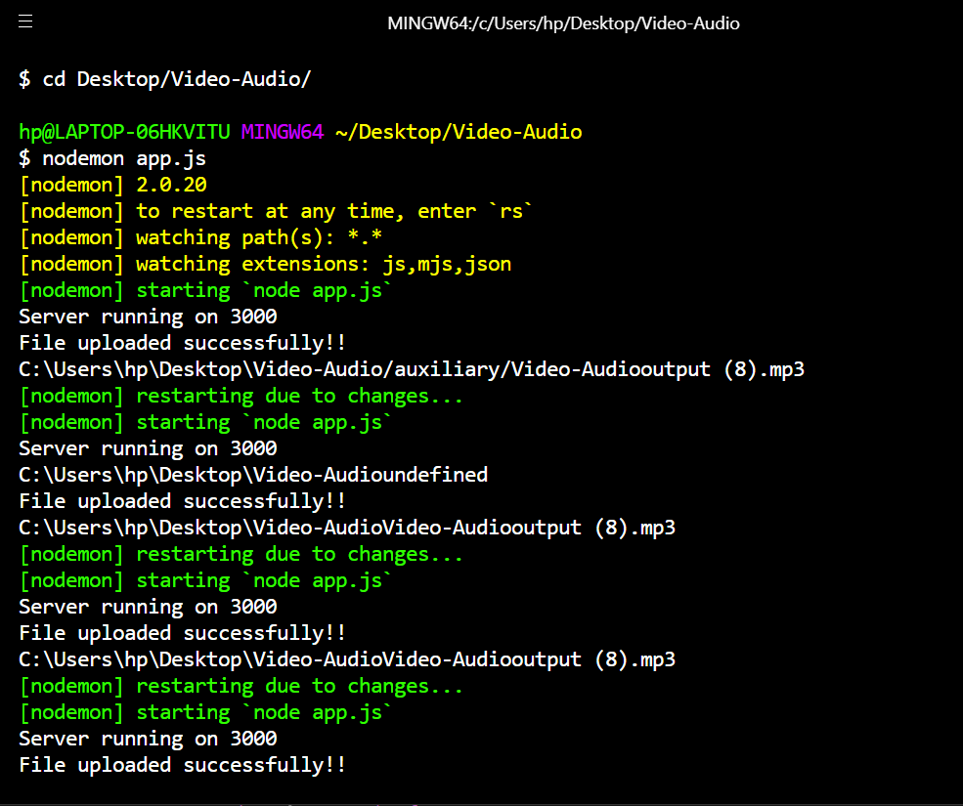
My server running on HyperTerminal using the module NodeMon

Slide 12
Conclusion: With the help of this application user can convert video to audio file(.mp3,.mov,.avi).Besides this, application also allows user to play the audio file and compose the timestamps, tags and comments that can be downloaded as a text file and can be used for further reference to audio file.

